Slide 1

Exercises Boolean functions – 5.8
Bogdan Teodora

Slide 2
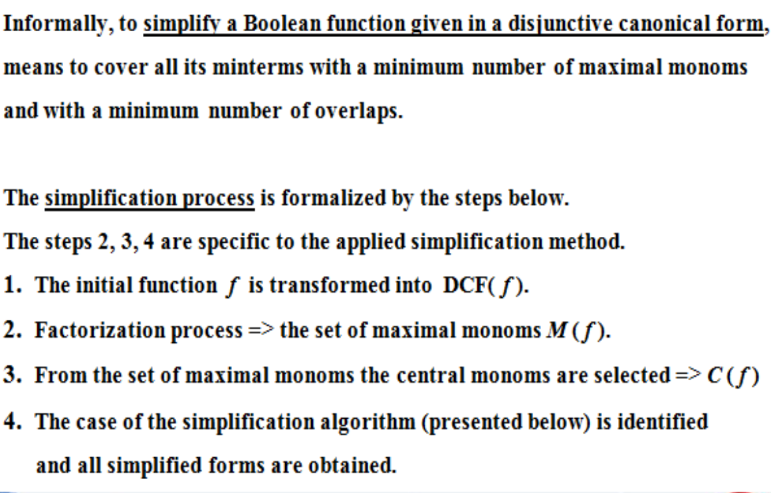

Slide 3


Slide 4


Quine’s method

Slide 5


Slide 6
Problem statement
5.Using Quine’s method, simplify the following Boolean functions given by their values 0.
8. f8(0,0,1) = f8(1,0,1) = f8(1,1,0) =0

Slide 7
Step 1
x1 | x2 | X3 | f(x1,x2,x3) | M1 | M5 | M6 | m0 | m2 | m3 | m4 | m7
0 | 0 | 0 | 1 | 1 | 1 | 1 | 1 | 0 | 0 | 0 | 0
0 | 0 | 1 | 0 | 0 | 1 | 1 | 0 | 0 | 0 | 0 | 0
0 | 1 | 0 | 1 | 1 | 1 | 1 | 0 | 1 | 0 | 0 | 0
0 | 1 | 1 | 1 | 1 | 1 | 1 | 0 | 0 | 1 | 0 | 0
1 | 0 | 0 | 1 | 1 | 1 | 1 | 0 | 0 | 0 | 1 | 0
1 | 0 | 1 | 0 | 1 | 0 | 1 | 0 | 0 | 0 | 0 | 0
1 | 1 | 0 | 0 | 1 | 1 | 0 | 0 | 0 | 0 | 0 | 0
1 | 1 | 1 | 1 | 1 | 1 | 1 | 0 | 0 | 0 | 0 | 1
We find the DCF(f) (disjunctive canonical form)
f8(0,0,1) = f8(1,0,1) = f8(1,1,0) =0
=> f8(0,0,0) = f8(0,1,0) = f8(1,0,0)=
=f8(0,1,1) = f8(1,1,1)=1
So DCF(f) = m0 ˅ m2 ˅ m3 ˅ m4 ˅ m7 = (x1 ˄ x2 ˄ x3) ˅ (x1 ˄ x2 ˄ x3) ˅ (x1 ˄ x2 ˄ x3) ˅ (x1 ˄ x2 ˄ x3) ˅ (x1 ˄ x2 ˄ x3)
The descending order => S = {(0,0,0) , (1,0,0) , (0,1, 0) , (0,1,1) , (1,1,1)}
Step 2

Slide 8

Step 3
 | x1 | x2 | x3
I | 0 | 0 | 0 | m0
II | 0 | 1 | 0 | m2
 | 1 | 0 | 0 | m4
III | 0 | 1 | 1 | m3
IV | 1 | 1 | 1 | m7
V= I + II | 0 | - | 0 | m0 ˅ m2=x1 x3 = max1
 | - | 0 | 0 | m0 ˅ m4 = x2 x3 = max2
VI = II + III | 0 | 1 | - | m2 ˅ m3 = x1 x2 = max3
VII = III + IV | - | 1 | 1 | m3 ˅ m7 = x2 x3 = max4
The set of maximal monoms ->M(f) = {x1 x3, x2 x3 , x1 x2, x2 x3} =
= {max1, max2, max3, max4}
Step 4
Step 5

Slide 9

Step 6
max monoms Minterms | max1 | max2 | max3 | max4
m0 | * | *
m2 | * |  | *
m3 |  |  | * | *
m4 |  | *
m7 |  |  |  | *
We circle the “*” which are unique on their rows
The 4th column has the * so central monoms set =
C(f) = {max4, max2} = {x2 x3, x2 x3}

Slide 10

Step 7
M(f) ≠ C(f) => The second case of simplification algorithm
=> g(x1, x2, x3) ===== max4 ˅ max2= x2x3 ˅ x2x3
Not.
Step 8

Slide 11
To identify the simplified forms we have to choose function h(x1, x2, x3), as simple as possible, such that it covers the minterm m2 uncovered by g(x1, x2 x3)
We choose the maximal monom having the maximum number of shaded “*” => max1 = x1 x3 and max3=x1x2
We remark that h(x1, x2, x3) = max1 ˅ max3 covers Sf-Sg
The forms of simplification:
f1(x1, x3, x3) = g(x1, x2, x3) ˅ h(x1, x2, x3) =max2 ˅ max4 ˅ max1
f2(x1, x3, x3) = g(x1, x2, x3) ˅ h(x1, x2, x3) =max2 ˅ max4 ˅ max3

